Slide 1
Project 1 - Analysis of Electric Vehicles in Washington, USA
Group Members
Hayley Win, Megan Greenhill, Kaumudi Mendis

Slide 2
Project Scope and Objectives
Project Aim
The aim of this project was to explore datasets and identify insights regarding electric vehicle usage and population in Washington, USA.
Research Questions
What brand of electric car is most popular in Washington?
What counties of Washington have the highest populations of electric cars?
What has the highest population in Washington out of battery EVs or plug-in EVs?
How has the adoption of electric vehicles changed over time in Washington (i.e. the last 3 years)? Can we project how this trend will continue?
Datasets Used
Dataset Title | Source
Electric Vehicle Population Data | Data.Gov
Electric Vehicle Population Size History by County | Data.Gov

Slide 3
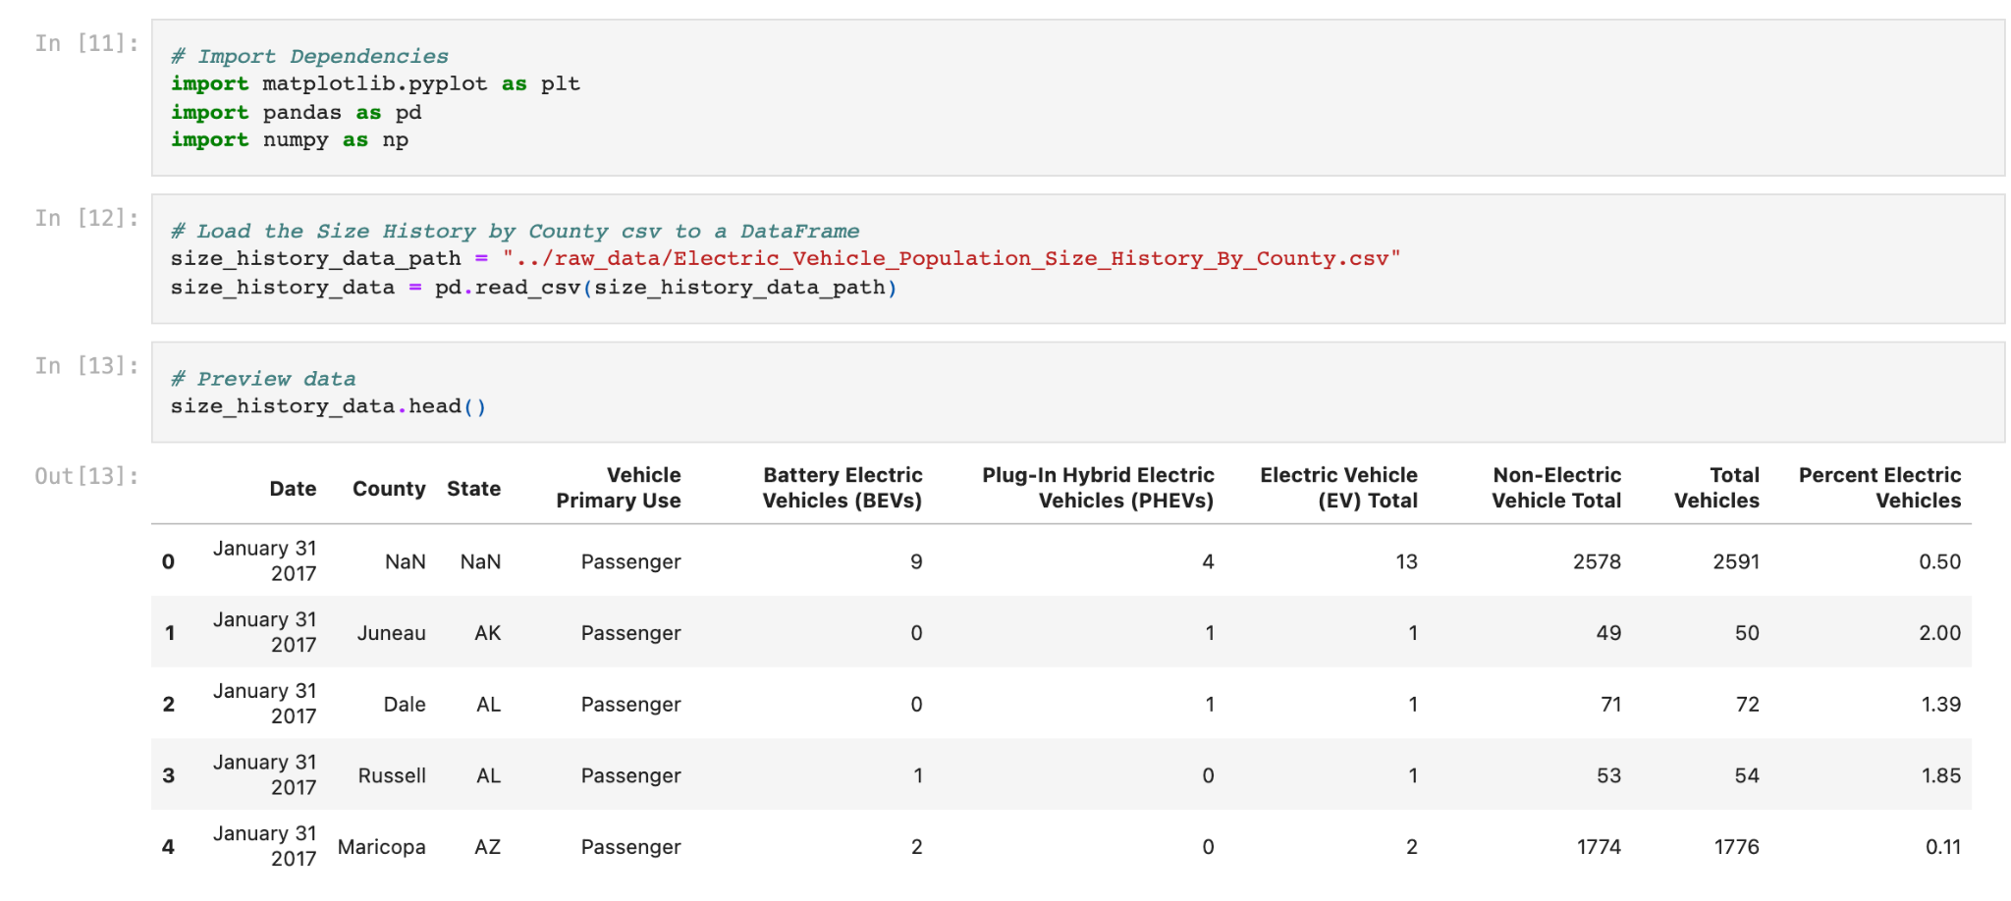
Process for Cleaning Data
Import Data
Preview data
Drop NaN values
Check unique values for column of interest to ensure data is usable
Save cleaned data

Slide 4
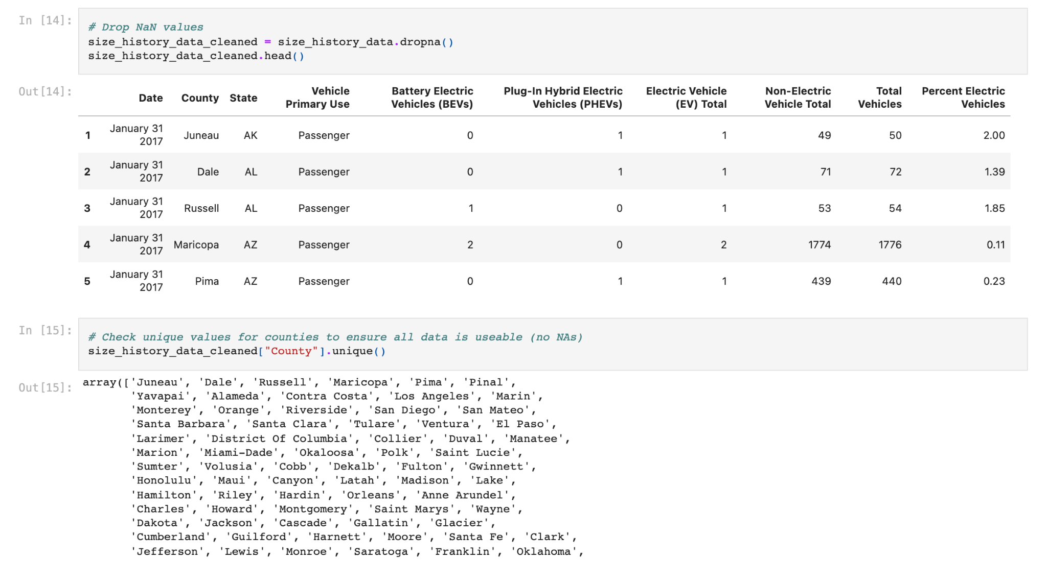
Process for Cleaning Data
Import Data
Preview data
Drop NaN values
Check unique values for column of interest to ensure data is usable
Save cleaned data

Slide 5
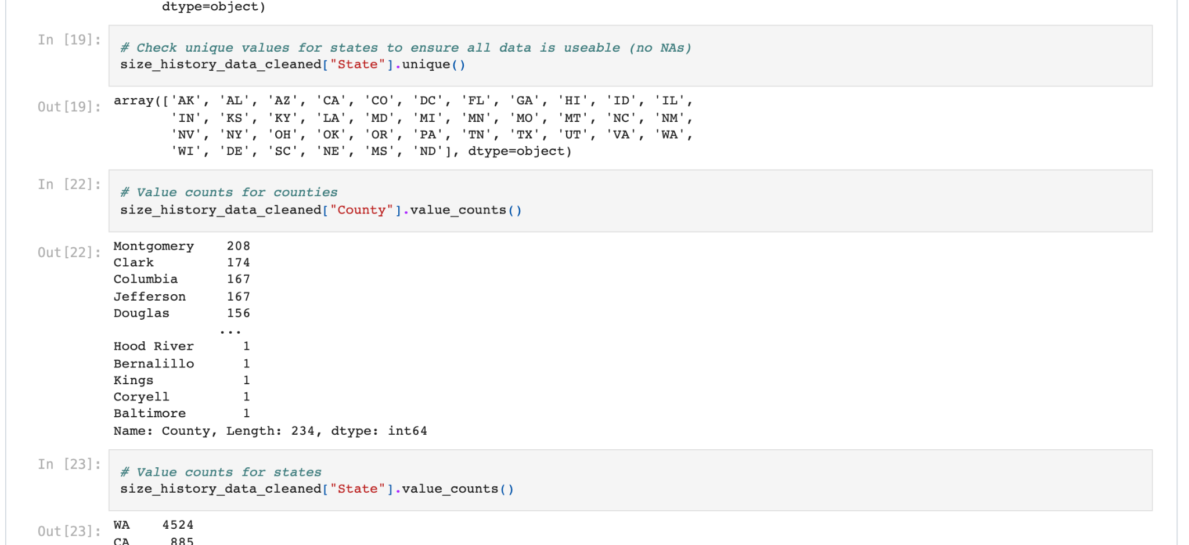
Process for Cleaning Data
Import Data
Preview data
Drop NaN values
Check unique values for column of interest to ensure data is usable
Save cleaned data

Slide 6
Challenges faced
We originally intended to use the Electric Vehicle Population Data dataset to find the population of electric vehicles across all US states.
Analysis of the data showed that despite this dataset including data for various US states, there was far more data available for Washington and its counties than data available for the other states and counties.
For example, the data summarised that Wisconsin only has a total of 4 electrical and non-electrical vehicles, which is highly inaccurate.
Because of this, we concluded that the dataframe does not include all vehicle data for other states as expected.
Thus we decided to reduce the data to only include Washington data, in order to prevent incorrect insights from other state data in our analysis.

Slide 7
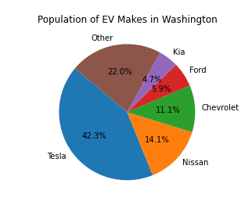
Popular Electric Vehicles in WA
Key operating players in Washington are Tesla with largest market share of 42.3% in Washington, followed by Nissan at 14.1% and Chevrolet with 11.1%.
How is this data useful?
Since the market is heavily dominated by the top 3 key players in Washington, other automotive brands may face a large barrier in gaining traction in this region. Considerations can be taken to explore other states or countries.

Slide 8
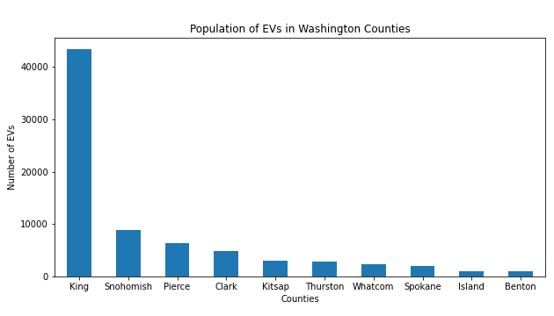
Population of EV in Each Washington County
As of October 31 2021, Washington had 82851 total electric vehicles, making up 1.36% of their total vehicles.
San Juan has the highest percentage of electric vehicles out of total vehicles with 2.96% (600 electric vehicles out of 20267 total vehicles).
King, Washington has by far the highest count of electric vehicles with 43352 vehicles, making up 2.78% of their total vehicles.

Slide 9
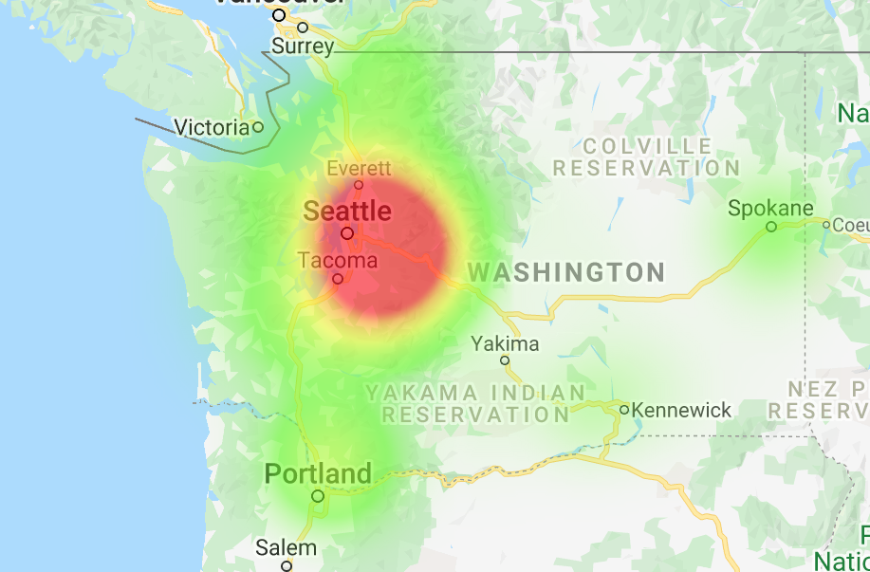
Population of EV in Each Washington County
This heatmap shows a high concentration of electric vehicles in the west of Washington, centred around Seattle. Seattle is Washington’s largest city and is in the county of King.
How is this data useful?
Automotive brands may use this data to determine the locations where residents may be more likely to purchase electric vehicles. This information could influence where brands advertise or establish dealerships.

Slide 10
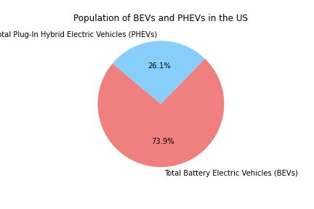
Most Popular Type of Electric Vehicles
In Washington, there are 61,335 (73.9%) battery electric vehicles and 21,719 (26.1%) plug-in hybrid electric vehicles. This shows there is a preference for battery electric vehicles.
We predict that this is because Tesla is the most popular electric vehicle brand in Washington, and all but one of Tesla’s vehicle models are battery electric vehicles. Additionally, electric vehicle customers may want to use more environmentally-friendly fuel sources, and thus may avoid vehicles that use gasoline (including hybrid vehicles.)
How is this data useful?
This information could be utilised by automotive brands to understand what type of electric vehicle is most in demand, which could influence what type of electric vehicle they choose to engineer.

Slide 11
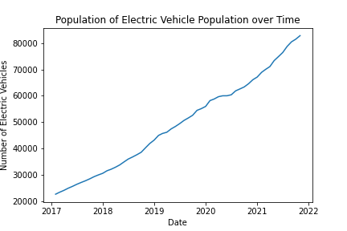
Adoption of EVs Over Time in Washington
The Electric Vehicle Population Size History dataset was used to analyse the change in population of electric vehicles between January 31 2017 and October 31 2021.
From the line graphs created, we can see that both the population and percentage of electric vehicles has consistently increased over the time recorded in the dataset.

Slide 12
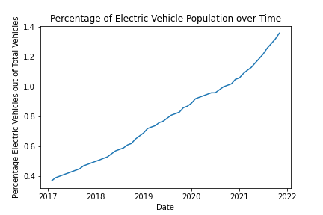
Adoption of EVs Over Time in Washington
We used this data to estimate that by January 31 2025, the population of electric vehicles in Washington may increase to 123,579, which may be 1.89% of a potential 6,522,205 vehicles in Washington at that time.
How is this data useful?
This data may be useful to automotive brands, their shareholders, and other stakeholders to indicate that there is consistently increasing demand for electric vehicles in Washington.

Slide 13
Conclusion
We believe this data analysis could be useful for electric vehicle brands to determine the market demand of electric vehicles in Washington. This could include determining locations to advertise their vehicles and establish dealerships, as well as identifying which make and type of electric vehicle is most popular.
Our analysis also demonstrates a steady increase of electric vehicle population in Washington, which is useful information to indicate to brands, shareholders, and other stakeholders that there is consistent demand for electric vehicles in Washington.

